Slide 1
Prevention and analysis of memory issues
Joost Rietdijk & Diana Koenraadt
FAFI/MC/SL
6 januari 2016 Eindhoven

Slide 2
64 bits

Slide 3
64 bits
Is NOT the solution to memory issues
The ceiling is HIGHER, not GONE!

Slide 4
Analysis of memory issues

Slide 5
Analysis
SDT
Mostly, STI will do the first quick analysis.
First opportunity to find memory issues is via SDT (System Diagnostics Tool, can be installed via ITMS).
SDT gives insight in logging and parameters of our and customer’s machines, including memory usage. (Note: DrYieldStar also offers ParameterHistory.)
For customer machine data requires access to PMA.
SL_SERV = WinServiceForm
SL_SHELL = UI
Available memory parameters: private bytes, virtual bytes, managed and LOH (32bit)

Slide 6
Analysis
Create memory dumps
YieldStar has an option to create memory dumps automatically at a set interval.
TODO screenshot

Slide 7
Analysis
MemoryDumpConverter and LeakAnalyzerGUI
LeakAnalyzerGUI: Tool that shows ‘leakiness’ of objects. Requires .csv input.
MemoryDumpConverter: Commandline tool to extract general data from memory dump to .csv for usage in LeakAnalyzerGUI.
If objects are suspect, involve STI. They know which memory usages are accepted. For example, caching mechanisms.
Caveats:
LeakAnalyzerGUI gives indicators of potential ‘leaks’. It doesn’t provide a root cause. For this, you need an actual memory dump. (=More data and more difficult to get out of the fab.)
This only applies to managed memory.
Objects that have a reference to eachother show similar graphs.
Total bytes does not include references objects, only the data in the object itself.
Focus on Instance Regression. The closer to 1, the larger the ‘leak’.

Slide 8
Analysis
Memory Diagnostics and Memory Analysis Toolkit
Shows all instances of a type, properties and fields of those instances and paths to root.
TODO wiki pagina
Used to:
Inspect data in an object and references it holds
Find ‘roots’, other objects that hold a direct or indirect reference to the inspected object.
Caveat:
Requires an actual memory dump, not a .csv

Slide 9
Some specific cases we analysed

Slide 10
Case 1: StarsContext

Slide 11
StarsContext
Root cause
Reported Issue: Memory leak found in DataCache.DataElement (P228762)
Found in STI Memory Test Case R023
When retrieving ECs/Diagnostics data, a StarsContext is required for GetECs call.
New StarsContext results in a DataElement being written to the DataCache
StarsContext requires an explicit Clear call to remove DataElements again. Failure to do so results in a ‘leak’.

Slide 12
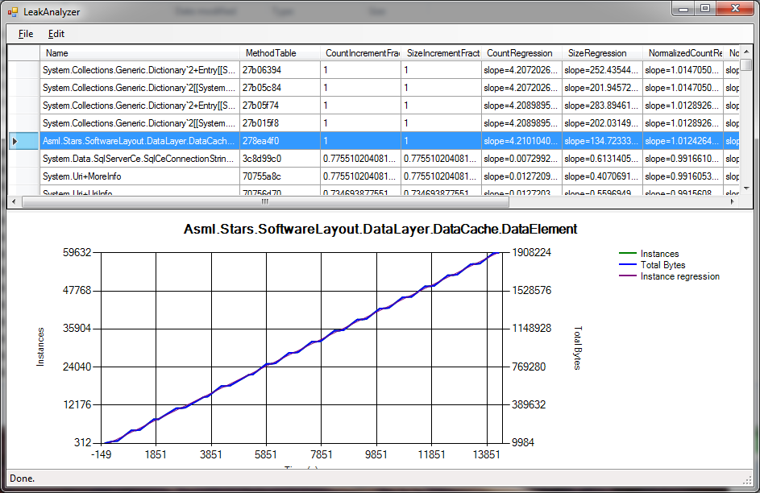
StarsContext
How to find/recognize root cause
Managed leak found with LeakAnalyzerGUI and MDMA Toolkit.
Over multiple process jobs the DataElements will steadily increase.
DataElement objects are used in many places
Root element is DataCache. You’ll have to find the ID of this element. Using this ID you can find the instantiation in code.
Todo screenshot MDMA

Slide 13
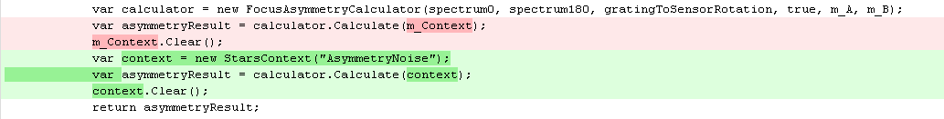
StarsContext
Solutions
Pass NeutralContext instead of creating a new StarsContext
Note: When the newly created context doesn’t contain required information, the NeutralContext is always used instead. Be sure to check whether you really need a new StarsContext.
Be sure to call Clear when you do create a new StarsContext
Possible improvements: Making context parameter optional, making StarsContext IDisposable

Slide 14
Case 2: Unmanaged memory usage in third party library

Slide 15
Unmanaged memory usage in third party library
Root cause
Reported Issue: A peak in Memory Usage during reporting leads to OutOfMemoryExceptions in StressTest runs (P234375)
Found in STI Memory Stress Test
Third party Cimetrix library reserves a buffer during SECS reporting. For a large message, a large buffer is allocated. The additional memory usage was seen to be as high as 1.5 GB.

Slide 16
Unmanaged memory usage in third party library
How to find/recognize root cause
Unmanaged memory usage typically found with SDT.
Managed memory stays the same but private bytes show increase.
Looking at timing becomes important: Inspected event- and tracelogging and found that this occurred during reporting.
By trial-and-error, including a test case where SECS reporting was disabled, we eventually showed that the root cause was in SECS reporting.
Grafieken van SECS reporting toont geen managed. Was toen niet echt in beeld, maar als screenshots die alsnog boven water krijgen zou dat mooi zijn. Opnieuw runnen van PRE en POST?

Slide 17
Unmanaged memory usage in third party library
Solutions
Moved SECS reporting to a separate service.
In 32 bits, each process has 4GB of Virtual memory at its disposal. By splitting off a process, you decrease the memory usage in the main process.

Slide 18
Case 3: Garbage Collector is blind to unmanaged data

Slide 19
Garbage Collector is blind to unmanaged data
Root cause
Reported Issue: AL01 fails due to invalid parameter message (P256566)
Found in beta test at customer fab
An unmanaged library from Microsoft was used to load images.
The Garbage Collection did not recognize images as a large object, because much of it was in unmanaged, which is invisible for the .Net Garbage Collector.
This led to OutOfMemory or ‘Parameter is not valid’ in logging

Slide 20
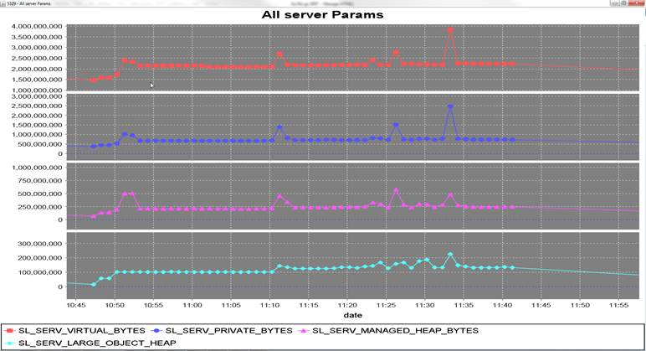
Garbage Collector is blind to unmanaged data
How to find/recognize root cause
Unmanaged memory usage typically found with SDT.
Private bytes shows a spike or increase of 1.5GB, while managed memory shows only 250MB increase.

Slide 21
Garbage Collector is blind to unmanaged data
How to find/recognize root cause
Looking at timing becomes important: Inspected event- and tracelogging and found that this occurred during Aligning optimization. Aligning team identified the problem, reproducible with a local test.

Slide 22
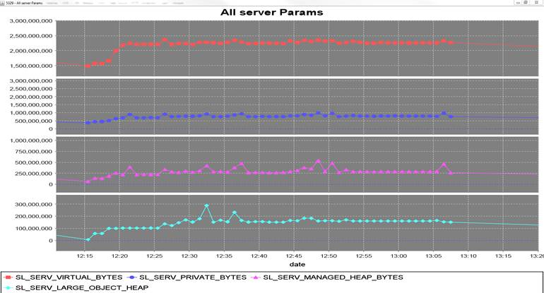
Garbage Collector is blind to unmanaged data
Solutions
Force Garbage Collection after every run. Note: loses performance but was accepted in this case.
Re-tested:

Slide 23
Case 4: Memory Leak found with System.IO.FileInfo

Slide 24
Memory Leak found with System.IO.FileInfo
Root cause
Reported Issue: Memory Leak found in System.IO.FileInfo during CD HV, Multilayer and DBF measurements (P232359)
Found by STI in Memory test
Large array of FileInfo objects was held as a member in File Cleaners. Whenever the Cleaner was called, this list was recreated and, furthermore, the list was held until the next call while it was not used anymore.
This caused unnecessary memory retention because the list was being held too long.

Slide 25
Memory Leak found with System.IO.FileInfo
How to find/recognize root cause
Managed leak found with LeakAnalyzerGUI and MDMA Toolkit.
On the path to root of the FileInfo objects, we found the Cleaners holding many of these instances.
Wenselijk: Plaatje van Path to root. Opnieuw runnen van PRE? Hoeft niet eens op oude SP te zijn. SP6 uit Git en replay draaien.

Slide 26
Memory Leak found with System.IO.FileInfo
Solutions
Don’t keep the FileInfo list as a member. This solves the fact that FileInfo objects were being held long after they were used.
Pull request diff tonen

Slide 27
Memory problems with System.IO.FileInfo
Root cause revisited
After retesting, the increase of memory usage on the managed heap was resolved. However, a lot of activity was still observed on the Large Object Heap.
Plaatje met veel activiteit op LOH!
This approach results in placing large arrays of FileInfo objects on the LOH. Because the LOH is never defragmented, this results in gaps in memory (fragmentation) that take up address space. This results in high virtual bytes usage and earlier OutOfMemory Exception.

Slide 28
Memory Leak found in System.IO.FileInfo
Solutions
To prevent memory fragmentation, a growing buffer was created (again as member of the File Cleaner!) of size 10.000 elements. If the number of objects exceeds that size, then double the buffer size and don’t decrease it again.
This limits LOH usage and fragmentation.
Main lesson learned:
When using large buffers, think not only about the amount of memory you’re using, but also about memory fragmentation.
When retesting, inspect the entire memory behavior again in your tools, not just the thing you thought you fixed. Be careful with confirmation bias.
After-case plaatje

Slide 29
Case 5: High memory usage during HMQ jobs

Slide 30
High memory usage during HMQ jobs
Root cause
Reported Issue: SL-0060 after > 4hrs of HMQ recipes (P229852, solved in P248899)
As part of SL-0060 escalation.
During every HMQ optimization step, a new RecipeContainer is created and loaded. The RecipeContainer from the previous step was not disposed.

Slide 31
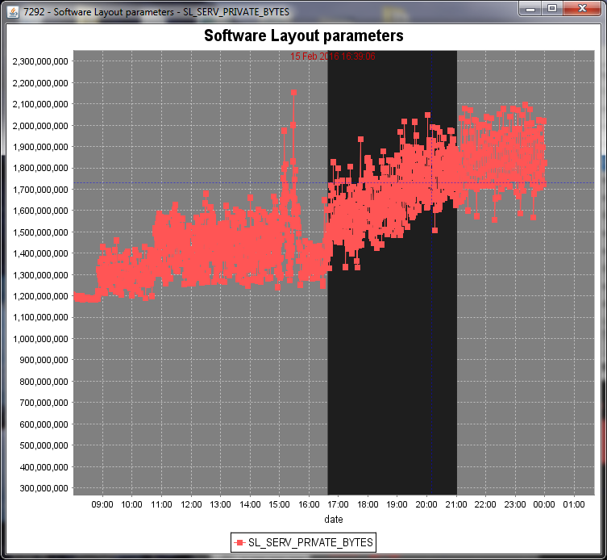
High memory usage during HMQ jobs
How to find/recognize root cause
Memory usage found with SDT, LeakAnalyzerGUI and MDMA Toolkit.
The increase in occurrences between optimization steps were found by LeakAnalyzerGUI. MDMA Toolkit showed path to root leading to WaferProcessingInstructionContext holding the RecipeContainers.

Slide 32
High memory usage during HMQ jobs
Solutions
Desired solution was quite simple: Ensure that RecipeContainers are disposed when they are no longer needed.
Actual implementation of this solution took a lot of effort, because the WaferProcessingInstructionContext held a reference to this RecipeContainer and many components took advantage of that fact.
This case illustrates that we hold a lot of data (potentially) during PJs. Ask yourself: Is this needed?
Lessons learned:
Dispose of objects when you don’t need them anymore. The Garbage Collection can’t collect that which is still being held.
Run memory tests when you introduce new large functionality or epic stories.

Slide 33
Prevention
1 day

Slide 34
Prevention
PRE/POST testing
How to test
When to test
What test cases (R061) are available off the shelf?

Slide 35
Prevention
STI & KPI’s

Slide 36
Tips and tricks
2 days

Slide 37
Tips & Tricks
Virtual bytes, what is it?
private bytes, what is it?
large object heap and managed heap, what are they?
Large object heap fragmentation
Large object heap cleaned by GC last
Objects larger than 85kb end up on the LOH. Also, double arrays of more than 1000 elements do. The LOH is visited by the Garbage Collector very infrequently and, unlike the other heaps, The Large Object Heap is never defragmented.

Slide 38
Tips & Tricks
Unmanaged memory
Unmanaged memory, what is it, what are the pitfalls (small native object with a lot of unmanaged memory behind it may not be cleared)

Slide 39
Tips & Tricks
The garbage collector, how does it work anyway?
Gen0, gen1, gen2 and large object heap

Slide 40
Links and additional information

Slide 41
Links and additional information
http://techwiki.asml.com/index.php/SDT
http://techwiki.asml.com/index.php/Memory_Leaks_-_1_-_Setup_for_memory_leak_investigation
TODO

Slide 42
And lastly…

Slide 43
64 bits
Is NOT the solution to memory issues
The ceiling is HIGHER, not GONE!

